Slide 1


Computer Networks
Introduction & Basics of Communication
Presented By:
Mr. Ramya Shah
Assistant Professor,
SCSDF, NFSU

Slide 2


who am I ?
Assistant Professor
(Cyber Security & Digital Forensics)
School of Cyber Security & Digital Forensics
National Forensic Sciences University
[An Institution of National Importance]
Mr. Ramya Shah

Slide 3


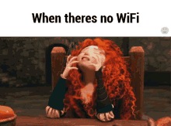
What Would Happen ?

Slide 4


Slide 5
WHAT IS NETWORK?
“A network is a group of connected, communicating devices such as computers and printers”

Slide 6
Are they Different?
internet & Internet
*All started in the year 1969
Notes:
An internet (note the lowercase i) is two or more networks that can communicate with each other.
The most notable internet is called the Internet (uppercase I ), composed of hundreds of thousands of interconnected networks.

Slide 7

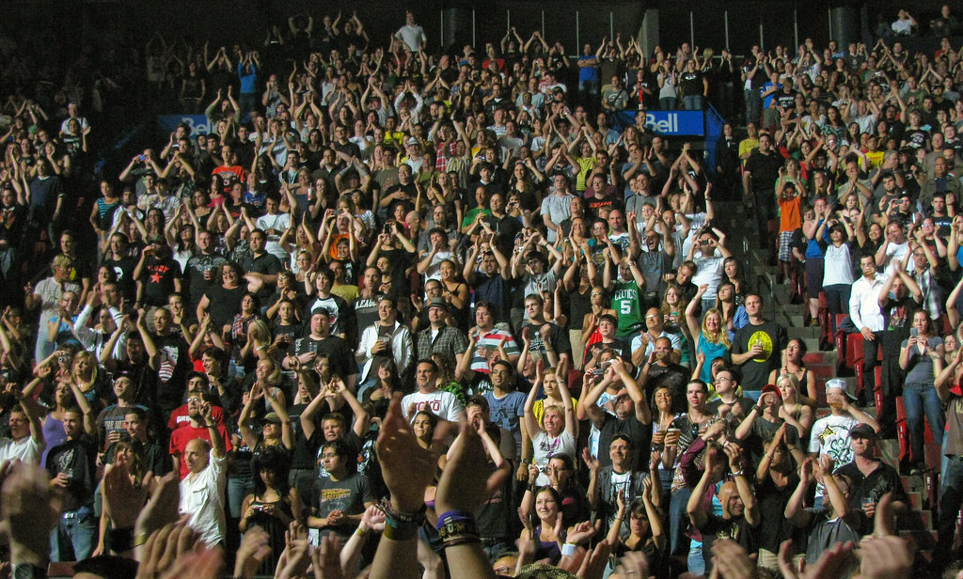
Market Caps
This Photo by Unknown Author is licensed under CC BY
EXPERTS THEN
EXPERTS NOW

Slide 8
Stories So Far
ARPANET – Advanced Research Project Agency (ARPA)
In mid 1960’s – Mainframe computers in research were stand-alone devices.
ARPA – DOD was interested to find a way to connect – share the research across the world – eliminate the cost of redundant research.
In 1967 - at Association for Computing Machinery (ACM) meeting, ARPA presented idea of ARPANET (a small network of connected Computers – IMP {Interface Message processor})
Notes:
Computers from different manufacturers were unable to communicate with one another.
The idea was that each host computer (not necessarily from the same manufacturer) would be attached to a specialized computer, called an interface message processor (IMP).

Slide 9

Stories So Far
ARPANET – Advanced Research Project Agency (ARPA)
1969 - ARPANET was a reality.
Four nodes, at the University of California at Los Angeles (UCLA), the University of California at Santa Barbara (UCSB), Stanford Research Institute (SRI), and the University of Utah, were connected via the IMPs to form a network.
Software called the Network Control Protocol (NCP) provided communication between the hosts.

Slide 10
Stories So Far
Birth of Internet
1972 - Vint Cerf and Bob Kahn, both of whom were part of the core ARPANET group, collaborated on - Internetting Project.
Plan – To connect different such networks together so one computer on one network can connect to the other computer on other network.
Challenges - overcome: diverse packet sizes, diverse interfaces, and diverse transmission rates, as well as differing reliability requirements.

Slide 11
Stories So Far
Birth of TCP/IP
Cerf and Kahn’s landmark 1973 paper outlined the protocols to achieve end-to-end delivery of data. This was a new version of NCP (Network Control Protocol).
This paper on transmission control protocol (TCP) included concepts such as encapsulation, the datagram, and the functions of a gateway.
October 1977 - An internet consisting of three different networks (ARPANET, packet radio, and packet satellite) was successfully demonstrated.
Notes:
Shortly thereafter, authorities made a decision to split TCP into two protocols: Transmission Control Protocol (TCP) and Internet Protocol (IP).
IP would handle datagram routing while TCP would be responsible for higher level functions such as segmentation, reassembly, and error detection. The new combination became known as
TCP/IP.

Slide 12
Stories So Far
1981 – CSNET was created - a network sponsored by the National Science Foundation (NSF). (Less Expensive
1983 - ARPANET split into two networks: MILNET for military users and ARPANET for nonmilitary users.
1986 - NSF, sponsored NSFNET, a backbone that connected five supercomputer centers located throughout the United States, a T-1 line with a 1.544-Mbps data rate, thus providing connectivity throughout the United States
1990 - ARPANET was officially retired and replaced by NSFNET.
Notes:
The network was conceived by universities that were ineligible to join ARPANET due to an absence of defense ties to DARPA.
CSNET was a less expensive network; there were no redundant links and the transmission rate was slower.

Slide 13
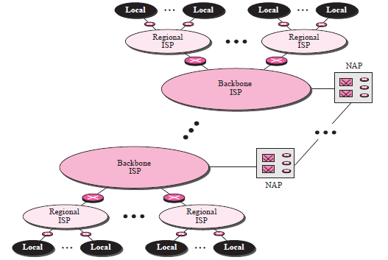
Today
1990s saw the explosion of the Internet applications due to the emergence of the World Wide Web (WWW) – Tim Berner’s Lee
The Internet today is not a simple hierarchical structure.
It is made up of many wide and local area networks joined by connecting devices and switching stations.
Notes:
Backbone ISPs are created and maintained by specialized companies.
To provide connectivity between the end users, these backbone networks are connected by complex switching stations (normally run by a third party) called network access points (NAPs).
Regional ISPs are small ISPs that are connected to one or more backbone ISPs. They are at the second level of hierarchy with a lesser data rate.
Local ISPs provide direct service to the end users. The local ISPs can be connected to regional ISPs or directly to backbone ISPs.

Slide 14
Protocols & Standards
A protocol is a set of rules that governs communication.
A protocol defines what is communicated, how it is communicated, and when it is communicated.
Key Elements of Protocol :
Syntax - Syntax refers to the structure or format of the data, meaning the order in which they are presented.
Semantics - Semantics refers to the meaning of each section of bits.
Timings – It refers to two characteristics: when data should be sent and how fast it can be sent.
Notes:
Communication between two people or two devices needs to follow some protocol.

Slide 15
Protocols & Standards
Standards – Essential for creating and maintaining an open and competitive market for equipment manufacturers and also in guaranteeing national and international interoperability of data and telecommunications technology and processes.
Standards Committees –
International Standards Organization (ISO).
International Telecommunications Union–Telecommunications Standards Sector (ITU-T).
American National Standards Institute (ANSI).
Institute of Electrical and Electronics Engineers (IEEE).
World Wide Web Consortium (W3C).
Open Mobile Alliance (OMA).

Slide 16
CRUX of Network – OSI Referential Model
OSI – Open Systems Interconnection.
Purpose - to show how to facilitate communication between different systems without requiring changes to the logic of the underlying hardware and software
Belief - OSI model would become the ultimate standard for data communications.
Fact - The TCP/IP protocol suite became the dominant commercial architecture because it was used and tested extensively in the Internet.
Notes:
Everyone believed that the OSI model would become the ultimate standard for data communications—but this did not happen. The TCP/IP protocol suite became the dominant commercial architecture because it was used and tested extensively in the Internet; the OSI model was never fully implemented.

Slide 17
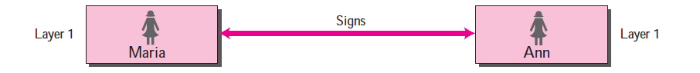
Protocol Layers
Scenario 1 :
Maria speaks only Spanish, and
Ann speaks only English.
Notes:
Since both have learned the sign language in their childhood, they enjoy meeting in a cafe a couple of days per week and exchange their ideas using signs.

Slide 18
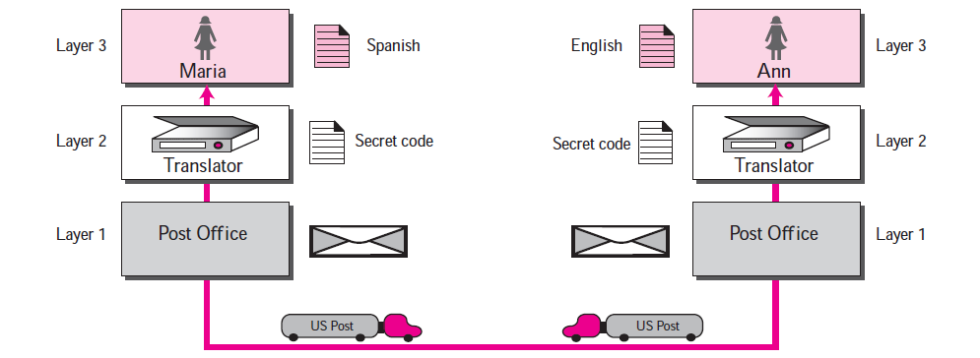
Protocol Layers
Scenario 2 :
Maria speaks only Spanish, and
Ann speaks only English and now Ann has to move to another town because of her job.
Notes:
Before she moves, the two meet for the last time in the same cafe. Although both are sad, Maria surprises Ann when she opens a packet that contains two small machines. The first machine can scan and transform a letter in English to a secret code or vice versa.

Slide 19
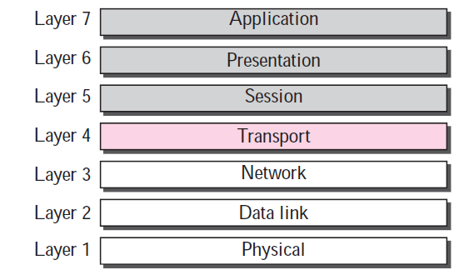
OSI Model – Layered Architecture
The OSI model is a layered framework for the design of network systems that allows communication between all types of computer systems.
Within a single machine, each layer calls upon the services of the layer just below it.
Notes:
Each layer defines a family of functions distinct from those of the other layers

Slide 20
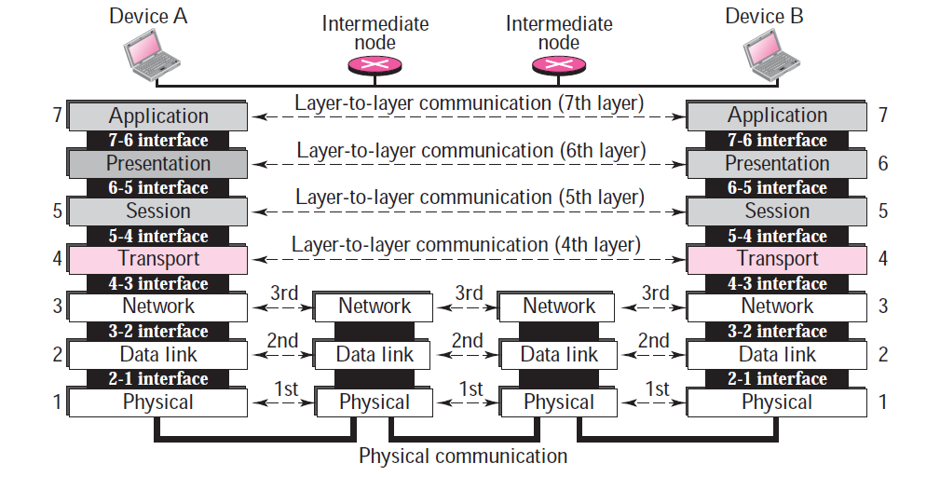
OSI Model – Layered Architecture
Between machines, layer x on one machine logically communicates with layer x on another machine.
This communication is governed by an agreed-upon series of rules and conventions called protocols.

Slide 21
OSI Model – Layered Architecture
Device A sends a message to device B (through intermediate nodes).
At the sending site, the message is moved down from layer 7 to layer 1.
At layer 1 the entire package is converted to a form that can be transferred to the receiving site.
At the receiving site, the message is moved up from layer 1 to layer 7.

Slide 22
OSI Model – Layered Architecture
The seven layers can be thought of as belonging to three subgroups.
Layers 1, 2, and 3—physical, data link, and network—are the network support layers; they deal with the physical aspects of moving data from one device to another (such as electrical specifications, physical connections, physical addressing, and transport timing and reliability).

Slide 23
OSI Model – Layered Architecture
Layers 5, 6, and 7—session, presentation, and application—can be thought of as the user support layers; they allow interoperability among unrelated software systems.
Layer 4, the transport layer, links the two subgroups and ensures that what the lower layers have transmitted is in a form that the upper layers can use.
The upper OSI layers are almost always implemented in software; lower layers are a combination of hardware and software, except for the physical layer, which is mostly hardware.

Slide 24
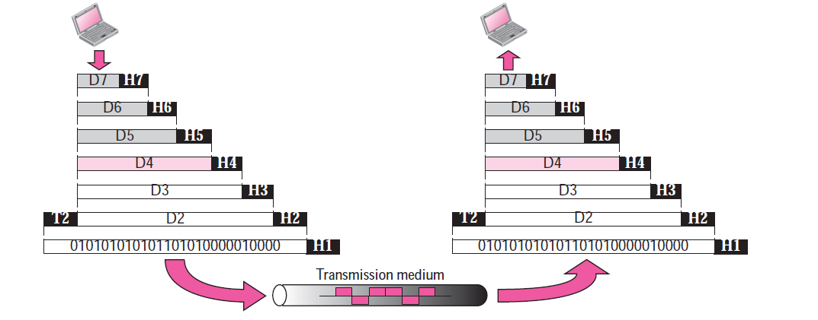
OSI Model – Layered Architecture
Exchange of Data - D7 data means the data unit at layer 7, D6 data means the data unit at layer 6, and so on. At each layer, a header can be added to the data unit.

Slide 25
OSI Model – Layered Architecture
When the formatted data unit passes through the physical layer (layer 1), it is changed into an electromagnetic signal and transported along a physical link.

Slide 26
OSI Model – Layered Architecture
Upon reaching its destination, the signal passes into layer 1 and is transformed back into digital form.

Slide 27
OSI Model – Layered Architecture
The data units then move back up through the OSI layers.
As each block of data reaches the next higher layer, the headers and trailers attached to it at the corresponding sending layer are removed, and actions appropriate to that layer are taken.

Slide 28
OSI Model – Layered Architecture
By the time it reaches layer 7, the message is again in a form appropriate to the application and is made available to the recipient.

Slide 29


Slide 30
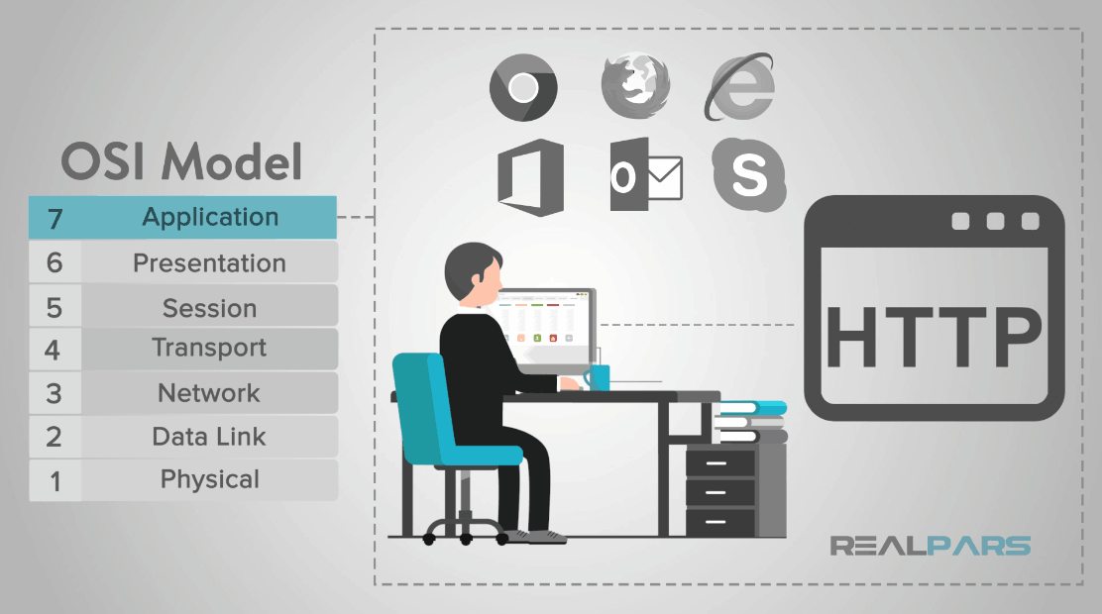
OSI Model – Layered Architecture
Notes:
The Application layer provides network services to the end user. These services are protocols that work with the data the client is using. One of these protocols may be HTTP that is used with web browsers such as Google Chrome, Firefox, and Internet Explorer.
Other examples of applications that use this layer are Office, Outlook, and Skype.
All of those interactive applications provide a set of services that allow the application layer to supply data to and receive data from the Presentation layer.

Slide 31
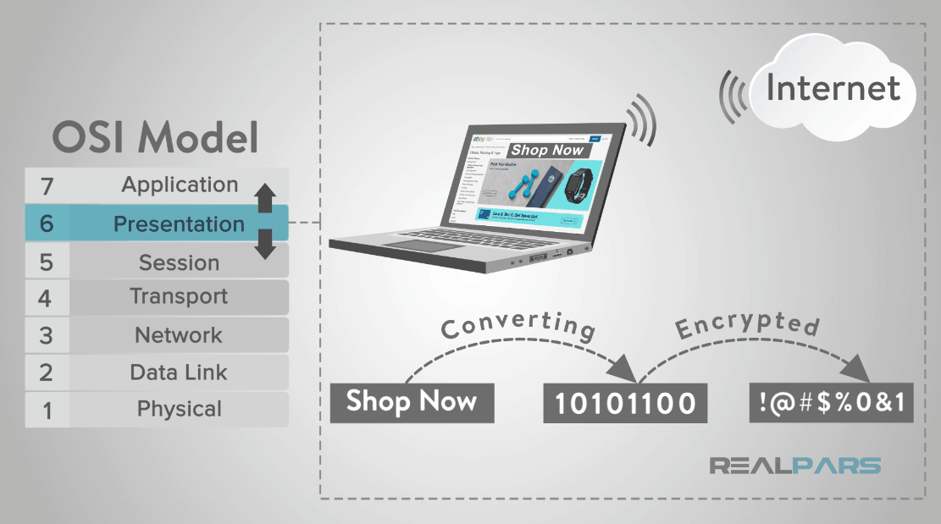
OSI Model – Layered Architecture
Notes:
The Presentation layer, or layer 6, performs the uncomplicated task of syntax processing or converting data from one format to another.
For example, say you are ordering something from an online store. These transactions are typically handled in a secure transmission which means that the data passing between the “store” or the Website Application will transmit encrypted data to the Presentation layer that will need to be decrypted and processed.
This layer handles translating the data from the top layer, which is presented in application format, to network format and vice versa.
After the Presentation layer processes the data from one format to another, the information is then passed to the Session layer or the Application layer depending on whether the data is transmitting or receiving.

Slide 32
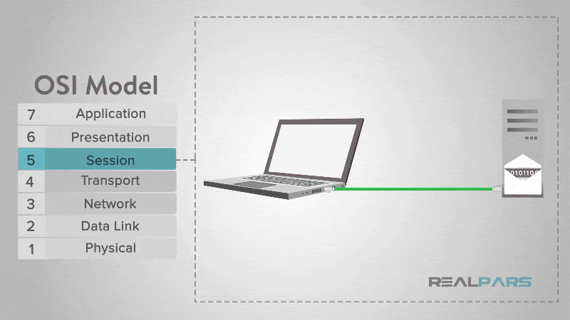
OSI Model – Layered Architecture
Notes:
At the Session layer, or layer 5, the construction, direction, and conclusion of connections between devices occur. This layer supports multiple types of connections as well as being responsible for authentication and reconnection if a network interruption should occur.
After the session is established the data then passes to or from the Transport layer.

Slide 33
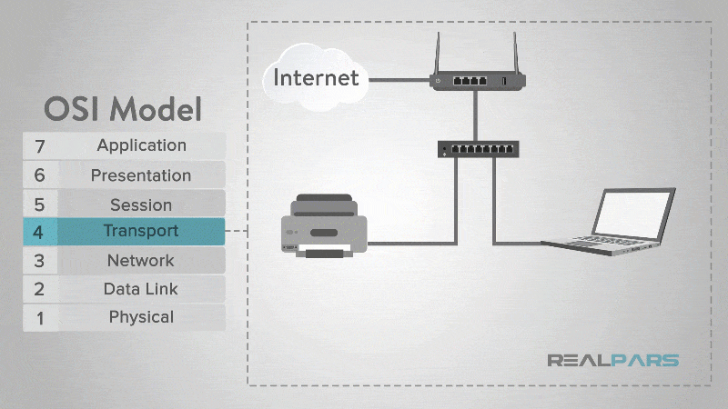
OSI Model – Layered Architecture
Notes:
The Transport layer, or layer 4, is responsible for the transmission of data across network connections. This layer coordinates how much data to send, how fast, where it goes, and these sort of things.
Of the most widely known protocols for internet applications, these services may be provided by “Transmission Control Protocol” or TCP and “User Datagram Protocol” or UDP. Other protocols may provide additional capabilities including error recovery, data flow, and retransmission.
Once the Transport layer has completed its function, the data is then passed to or from the Network layer.

Slide 34
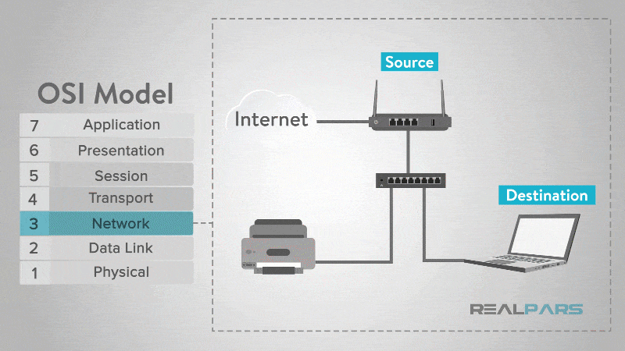
OSI Model – Layered Architecture
Notes:
The Network layer, or layer 3, handles the routing of data.
After the data arrives at this layer, each frame of data is examined to conclude if the data has reached its ultimate target. The layer sends data to the correct destination on outgoing transmissions and receives incoming transmissions as well. The IP portion of TCP/IP is the commonly known network layer for the Internet.
This layer also manages the mapping between logical addresses and physical addresses, for IP addresses, this is accomplished through Address Resolution Protocol or ARP.

Slide 35
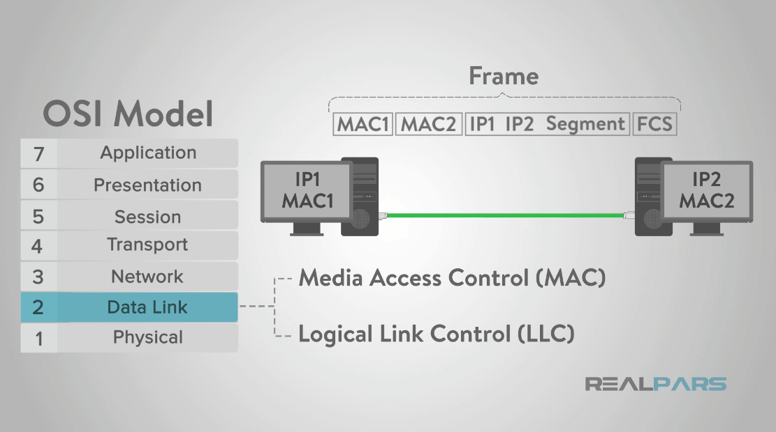
OSI Model – Layered Architecture
Notes:
The Data Link layer, or layer 2, is considered the most complex of the layers. This layer is often divided into sublayers called Media Access Control or MAC and Logical Link Control or LLC.
The layer sets up links across the physical network. When this layer received data from the Physical layer, it checks for transmission errors and then packages the bits into data frames.

Slide 36
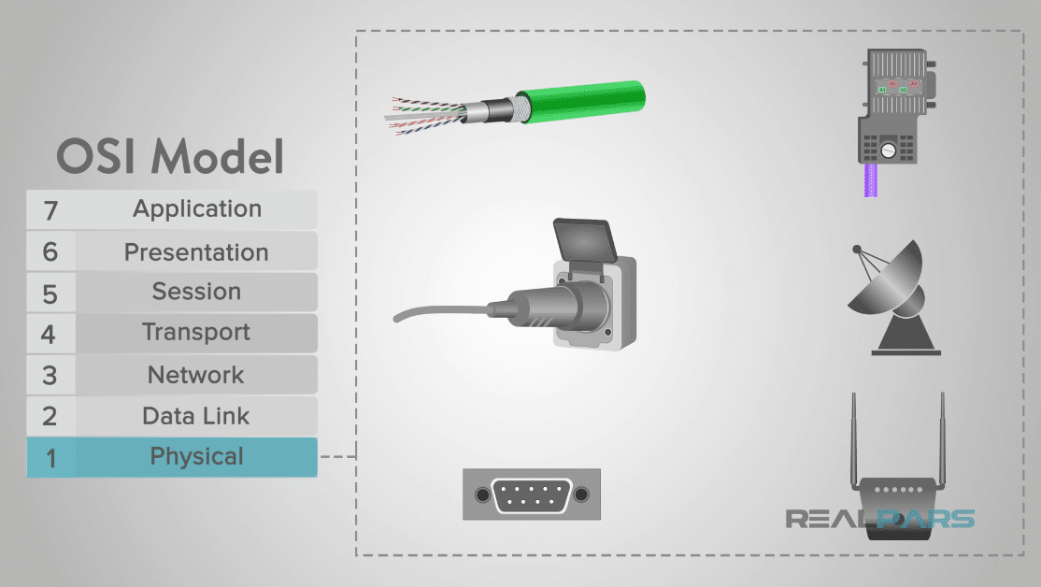
OSI Model – Layered Architecture
Notes:
The Physical layer, or layer 1, is the electrical/physical layer of the model. This layer encompasses the network cables, power plugs, cable pinouts, wireless radio frequencies, connectors, transceivers, receivers, repeaters, pulses of light, electric voltages, etc.

Slide 37
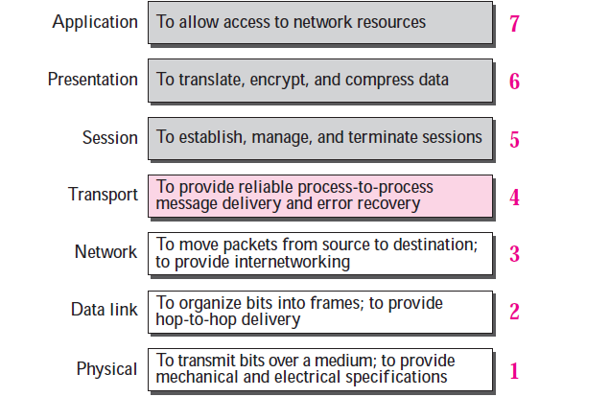
OSI Model – Layered Architecture

Slide 38
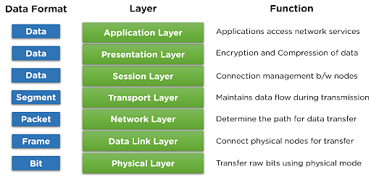
OSI Model – Layered Architecture

Slide 39
TCP/IP Model – A Layered Architecture
The TCP/IP model, also known as the Internet Protocol Suite, is a set of networking protocols and a conceptual framework that provides the basis for communication on the internet and many private networks.
It was developed by the United States Department of Defense (DoD) for their ARPANET project, which was a precursor to the modern internet.
The TCP/IP model consists of four layers, each responsible for specific aspects of data communication and networking.
The TCP/IP protocol suite was developed prior to the OSI model.

Slide 40
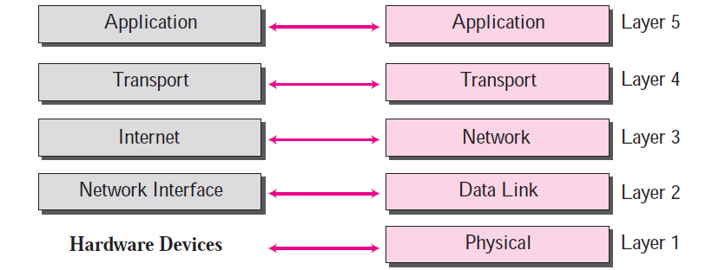
TCP/IP Model – A Layered Architecture

Slide 41
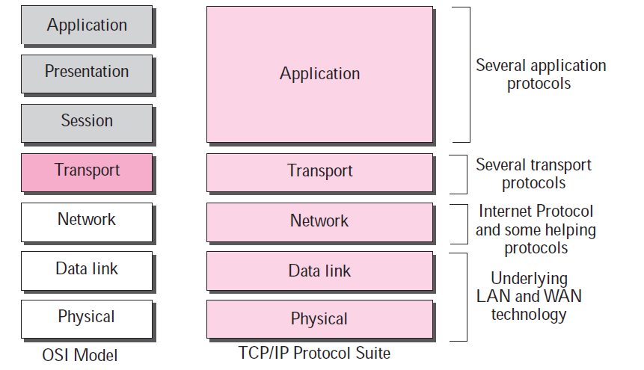
TCP/IP Model – A Layered Architecture

Slide 42
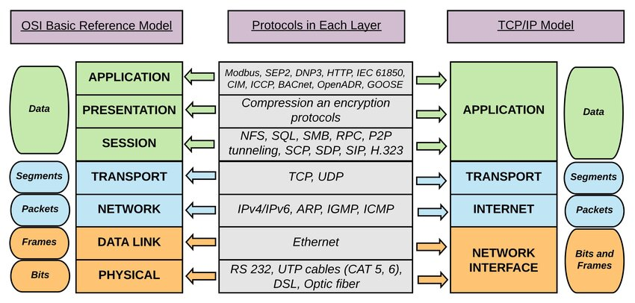
TCP/IP Model – A Layered Architecture

Slide 43
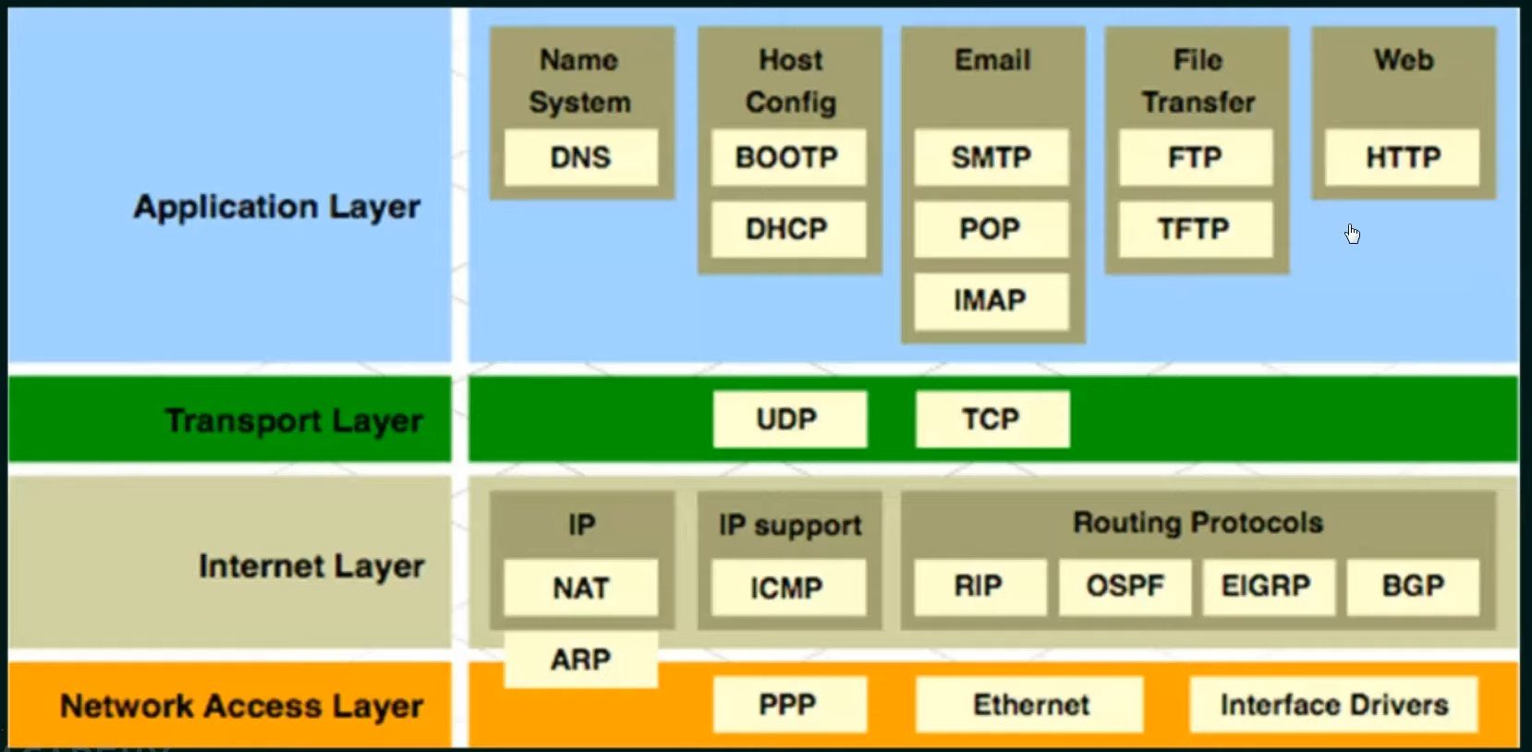
TCP/IP Protocol Suite

Slide 44
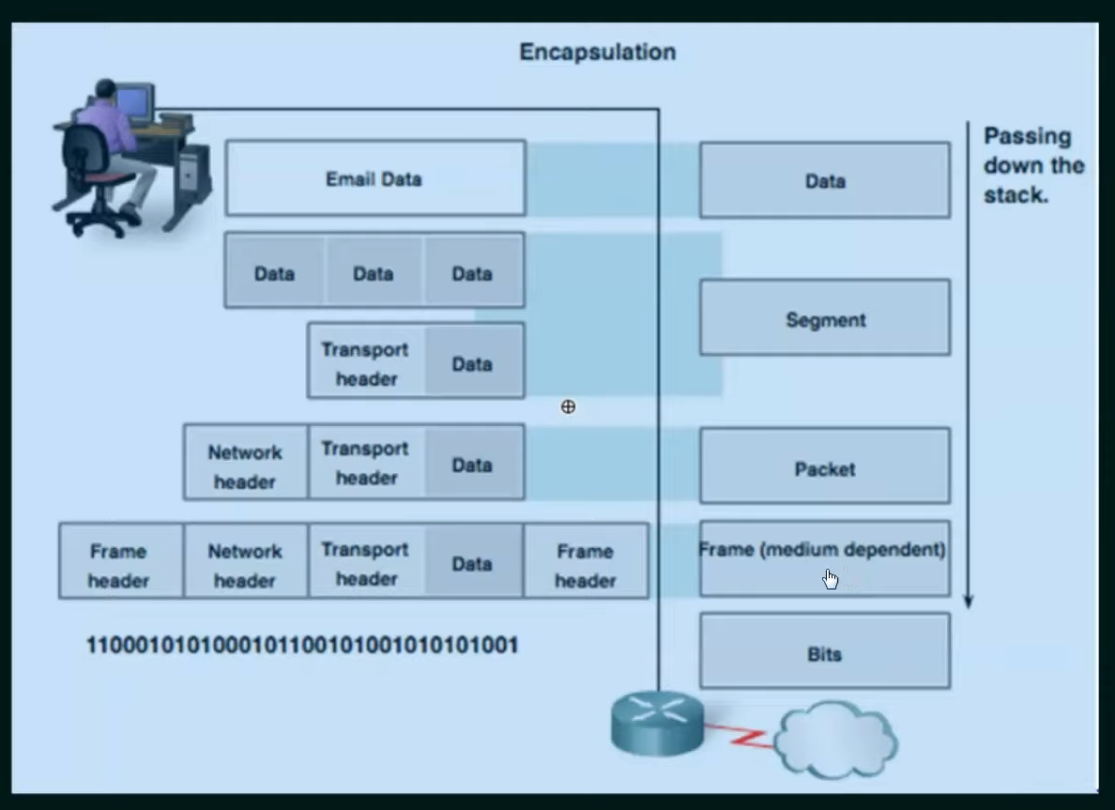
Protocol Data Unit (PDU)

Slide 45
OSI v/s TCP/IP
Parameters | OSI | TCP/IP
Layers | 7 Layers | 4 Layers (Excluding Hardware)
Origin | Developed by the International Organization for Standardization (ISO) to standardize networking concepts and promote interoperability between different vendors and systems. | Developed by the United States Department of Defense (DoD) for their ARPANET project, which later became the foundation of the modern internet.
Real-world Usage: | The OSI model is more of a theoretical framework and is less commonly used in practice. | TCP/IP is the model that forms the basis of the internet and is widely used in networking protocols today.
Number of Layers: | More layers add complexity, but also provide a finer level of detail for understanding networking processes. | Fewer layers make it less complex and easier to implement.

Slide 46
OSI v/s TCP/IP
Parameters | OSI | TCP/IP
Complexity | High | Low
Encapsulation | More layers lead to more encapsulation points and headers, which can add to the complexity of data transmission. | Encapsulation is simpler, involving fewer headers and encapsulation points.
Protocols | While OSI doesn't specify protocols, it provides a framework for developing protocols. | It includes well-known protocols like HTTP, FTP, SMTP, and others.
Flexibility | The OSI model is more rigid and may require additional adaptations to work with different technologies. | TCP/IP is more flexible and allows for easier adaptation to different networking technologies.
Visibility | Layers are strictly separated, and each has a distinct and well-defined function. | Layers are not as strictly separated, and some functionalities might overlap between layers.

Slide 47
OSI v/s TCP/IP
Parameters | OSI | TCP/IP
Reliability | It is less reliable than TCP/IP Model. | It is more reliable than OSI Model.
Real-world Application | OSI is often used for educational purposes and for understanding networking concepts. It is not directly implemented in most practical networking scenarios. | TCP/IP is the model used for practical networking, making it directly applicable to real-world scenarios.

Slide 48
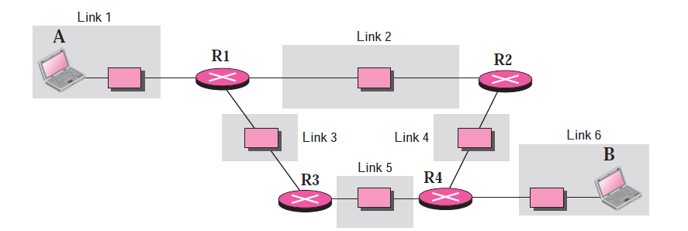
TCP/IP Model – A Layered Architecture
Link : A link is a network that allows a set of computers to communicate with each other.
A link, can be a LAN (local area network) serving a small area or a WAN (wide area network) serving a larger area.

Slide 49
TCP/IP Model – A Layered Architecture
Layer 1 : Physical Layer (Only for Understanding) –
TCP/IP does not define any specific protocol for the physical layer. It supports all of the standard and proprietary protocols.
At this level, the communication is between two hops or nodes, either a computer or router. The unit of communication is a single bit.
When the connection is established between the two nodes, a stream of bits is flowing between them.

Slide 50
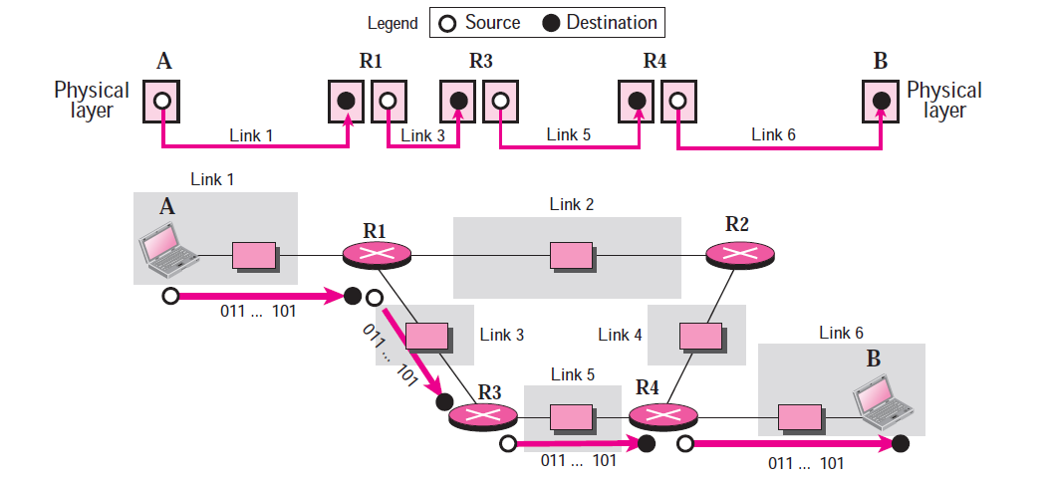
TCP/IP Model – A Layered Architecture
Layer 1 : Physical Layer (Only for Understanding) –
The physical layer, however, treats each bit individually.
If a node is connected to n links, it needs n physical-layer protocols, one for each link.

Slide 51
TCP/IP Model – A Layered Architecture
Layer 1 : Data Link Layer –
At this level, the communication is also between two hops or nodes. The unit of communication however, is a packet called a frame.
A frame is a packet that encapsulates the data received from the network layer with an added header and sometimes a trailer. The head, among other communication information, includes the source and destination of frame.
The destination address is needed to define the right recipient of the frame because many nodes may have been connected to the link.
The source address is needed for possible response or acknowledgment as may be required by some protocols.

Slide 52
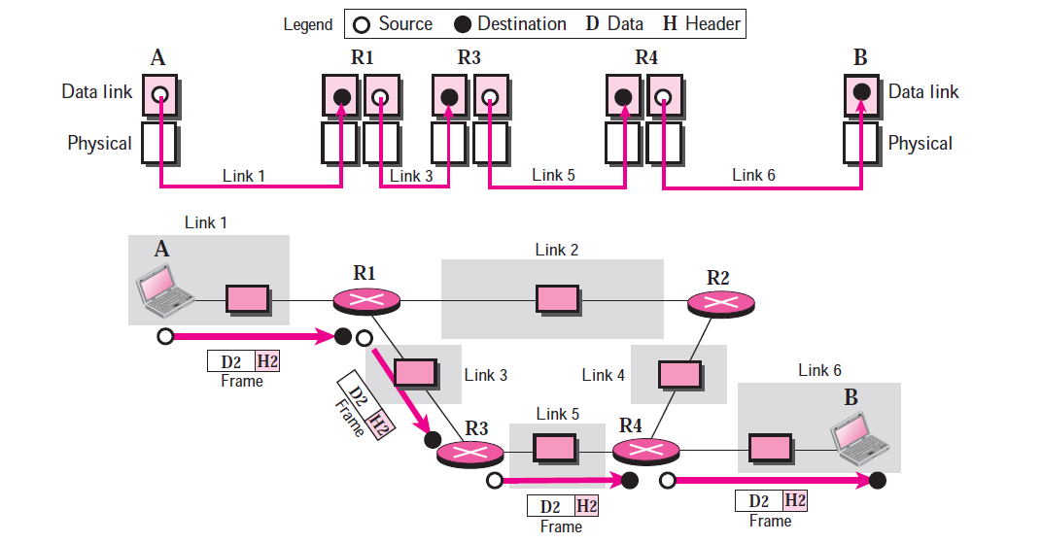
TCP/IP Model – A Layered Architecture
Layer 1 : Data Link Layer –

Slide 53
TCP/IP Model – A Layered Architecture
Layer 2 : Network Layer –
At the network layer (or, more accurately, the internetwork layer), TCP/IP supports the Internet Protocol (IP).
The Internet Protocol (IP) is the transmission mechanism used by the TCP/IP protocols.
IP transports data in packets called datagrams, each of which is transported separately.
Datagrams can travel along different routes and can arrive out of sequence or be duplicated.
IP does not keep track of the routes and has no facility for reordering datagrams once they arrive at their destination.

Slide 54
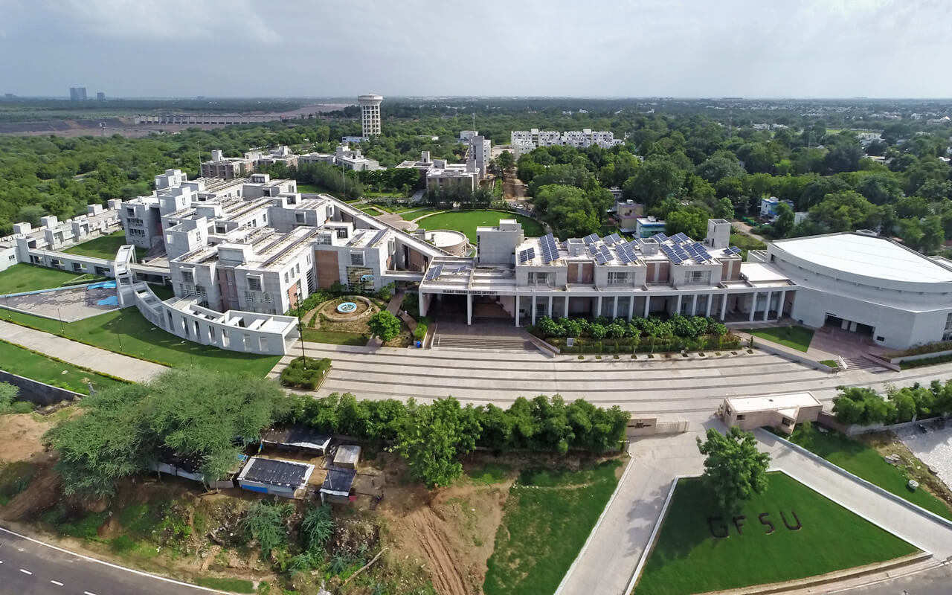




THANK YOU!
Mr. Ramya Shah
ramyashah4@gmail.com
@mr_ramya_shah
+ 91 8200049700

